Slide 1
IVSign: Interpretable Vulnerability Signature via Code Embedding and Static Analysis
Presenter:
Ao Ding
School of Electronic Information and Electrical Engineering,
Shanghai Jiao Tong University, China
Ao Ding, Gaolei Li, Xiaoyu Yi, Yuchen Liu
DCDS 2023

Slide 2
Table of Contents
Background
Related Work
The Proposed IVSIGN framework
Experiments
Discussion
Summary
Ao Ding IVSign: Interpretable Vulnerability Signature via Code Embedding and Static Analysis

Slide 3
Background: Necessity
The software has become and will increasingly become an integral part of our lives in all aspects of social life.
Various reasons such as software complexity, code reuse and so on.
Software vulnerabilities play a major role in many cyberspace security issues.
How to detect and locate vulnerabilities before software release?
The self-limiting nature of developers.
It is essential to seek the help of automated software vulnerability detection.
Ao Ding IVSign: Interpretable Vulnerability Signature via Code Embedding and Static Analysis

Slide 4
Background: Classification of automated SVD
Automated software vulnerability detection from source codes falls into two main categories:
Type 1: Pattern-driven approaches:
These are mainly various approaches based on static analysis and some of them are reprocessed.
Type 2: Data-driven approaches:
It aims to use data mining and deep learning methods to extract vulnerability features and classify vulnerabilities.
Ao Ding IVSign: Interpretable Vulnerability Signature via Code Embedding and Static Analysis

Slide 5
Background: Problem of automated SVD
Both types of methods have certain problems:
Pattern-driven:Defining accurate and comprehensive patterns is very difficult.
Data-driven:Limited to coarse-grained constraints.
A combination of pattern-driven approaches and data-driven approaches？
Ao Ding IVSign: Interpretable Vulnerability Signature via Code Embedding and Static Analysis

Slide 6
Table of Contents
Background
Related Work
The Proposed IVSIGN framework
Experiments
Discussion
Summary
Ao Ding IVSign: Interpretable Vulnerability Signature via Code Embedding and Static Analysis

Slide 7
Pattern-driven Approaches
Pattern-driven approaches are devoted to finding and defining more precise vulnerability patterns as a way to match vulnerabilities and reduce false positives:
- A large number of static analysis frameworks are designed to detect vulnerabilities.(e.g. Clang Static Analyzer, Infer, Checkmark)
- code similarity-based approaches: convert error code fragments within specific boundaries (e.g. Functions, Slice) into various forms of vulnerability signatures such as hashes, dependency graphs or feature vector.(e.g. Redebug, MVP, Tracer)
Ao Ding IVSign: Interpretable Vulnerability Signature via Code Embedding and Static Analysis

Slide 8
Data-driven Approaches
Data-driven approaches are usually divided into three types depending on the granularity of detection:
Type 1: Method-level:
Token Embedding、VgDetector、REVEAL、Code2Seq
Type 2: Slice-level:
Vuldeepecker、SYSEVR、Deepwukong
Type 3: Statement-level:
VELVET、IVDETECT、ICVH
Method-level and slice-level approaches train and perform coarse-grained prediction.
Statement-level approaches report a set of statements which may be incomplete and disconnected.
These approaches are still insufficient when pinpointing bug-triggering paths.
Ao Ding IVSign: Interpretable Vulnerability Signature via Code Embedding and Static Analysis

Slide 9
Code Embedding
The aim of code embedding is to generate a uniform, low dimensional vector representation of the code, which allows the model to extract and learn code features:
- A number of existing approaches are already widely applied, which are all static embedding methods. (e.g. Doc2Vec, GloVe, Word2Vec)
- With the transformer model being used for source code vulnerability detection, it is expected that higher-quality embeddings of source code can be generated dynamically.(e.g. CodeBert)
Ao Ding IVSign: Interpretable Vulnerability Signature via Code Embedding and Static Analysis

Slide 10
Table of Contents
Background
Related Work
The Proposed IVSIGN framework
Experiments
Discussion
Summary
Ao Ding IVSign: Interpretable Vulnerability Signature via Code Embedding and Static Analysis

Slide 11
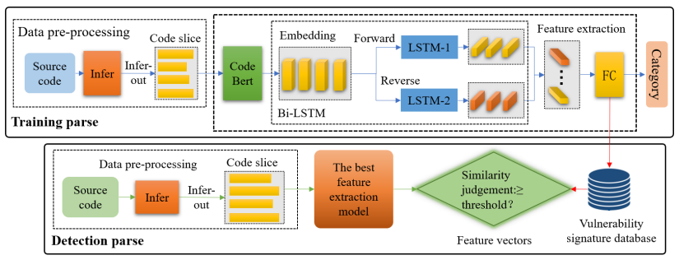
Overview of IVSign
It shows how IVSign combines the advantages of both approaches:
The powerful feature extraction capabilities of data-driven approaches and the ability of pattern-driven approaches to provide rich vulnerability information are blended.
Ao Ding IVSign: Interpretable Vulnerability Signature via Code Embedding and Static Analysis
[1] Liang, Ruofan, et al. "Knowledge consistency between neural networks and beyond." in International Conference on Learning Representations (2020).

Slide 12
IVSign: Data Pre-processing
For the data-driven approaches, it need to preprocess the source code to leverage its feature extraction capabilities:
The source code is first initially detected using pattern-driven approaches.
In IVSign, we use Infer from facebook.
To filter out statements that are irrelevant to the vulnerability as much as possible, the IVSign derives vulnerable traces on data dependency graphs rather than control-flow graphs.
Code Slice:
[1] Liang, Ruofan, et al. "Knowledge consistency between neural networks and beyond." in International Conference on Learning Representations (2020).
Ao Ding IVSign: Interpretable Vulnerability Signature via Code Embedding and Static Analysis

Slide 13
IVSign: Feature Extraction
First, use CodeBert to obtain embedding for code slicing. Once the embedding of the vulnerability trace is available, the next step is to select a neural network:
Which neural network can better bring up the features of the vulnerability trace?
context information
A neural network for NLP(RNNS)
earlier/later statements
Bi-LSTM
[1] Liang, Ruofan, et al. "Knowledge consistency between neural networks and beyond." in International Conference on Learning Representations (2020).
Ao Ding IVSign: Interpretable Vulnerability Signature via Code Embedding and Static Analysis

Slide 14
IVSign: Feature Extraction
Extracting Features Using Bi-LSTM and MLP:
[1] Liang, Ruofan, et al. "Knowledge consistency between neural networks and beyond." in International Conference on Learning Representations (2020).
Ao Ding IVSign: Interpretable Vulnerability Signature via Code Embedding and Static Analysis

Slide 15
IVSign:Generating Vulnerability Signature
IVSign uses signature matching to incorporate the advantages of pattern-driven approaches:
- IVSign saves a model that has undergone extensive data training first.
- For a saved model, a set of pre-processed source code slices V is simply taken as input to obtain its corresponding feature vector EV , which then becomes the signature of the vulnerability.
- Feeding the training set into the model in turn, IVSign can obtain the signatures of all known vulnerabilities.
Ao Ding IVSign: Interpretable Vulnerability Signature via Code Embedding and Static Analysis

Slide 16
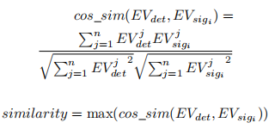
IVSign:Detection Phase
Once IVSign has a database of vulnerability signatures, we can test for unknown source code:
- First, the source code is pre-processed, the traces of the vulnerabilities are extracted to obtain the set of source code slices.
- Then, fed into the same model as the signature generation to obtain the feature vector of the potential vulnerability.
- IVSign chooses the cosine similarity measure to measure the similarity.
Ao Ding IVSign: Interpretable Vulnerability Signature via Code Embedding and Static Analysis

Slide 17
Table of Contents
Background
Related Work
The Proposed IVSIGN framework
Experiments
Discussion
Summary
Ao Ding IVSign: Interpretable Vulnerability Signature via Code Embedding and Static Analysis

Slide 18
Dataset
IVSign is inspired by TRACE, whose dataset contains both synthetic and real-world vulnerabilities, and are somewhat random. Therefore, its dataset is followed by us:
Type 1: Real World Vulnerability:
It includes 16 vulnerabilities found from CVE reports and previous work, covering 20 real projects.
Type 2: Juliet Test Suite:
Juliet Test Suite consists of a large set of small programs each of which has a common vulnerability. We used 7 CWEs, with a total of 5383 applets for our analysis.
Type 3: Online Tutorial:
It contains 5 examples from online tutorials on secure programming provided by OWASP.
Ao Ding IVSign: Interpretable Vulnerability Signature via Code Embedding and Static Analysis

Slide 19
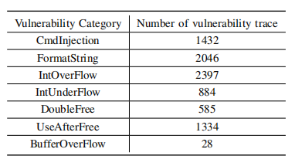
Dataset
The results of the pre-processing of our dataset:
The number of vulnerabilities in the dataset is unequal and varies considerably due to each vulnerability category.
Ao Ding IVSign: Interpretable Vulnerability Signature via Code Embedding and Static Analysis

Slide 20
Handling of Data Unbalance Categories
To reduce the impact of category imbalance on model training, we should take some measures:
- Each type of vulnerability is divided into the training, validation, and test sets in a ratio of 8:1:1.
- IVSign introduces a cross-entropy loss function with weights.
Ao Ding IVSign: Interpretable Vulnerability Signature via Code Embedding and Static Analysis

Slide 21
Hyper Parameter
There are five hyper-parameters in this paper:
- batch_size
- lr
- hidden_size: the size of the LSTM hidden layer
- fc1_size: the size of the output layer of the first fully connected network
- dropout: the fully connected layer dropout
Hyper Parametric Combianations:
Ao Ding IVSign: Interpretable Vulnerability Signature via Code Embedding and Static Analysis

Slide 22
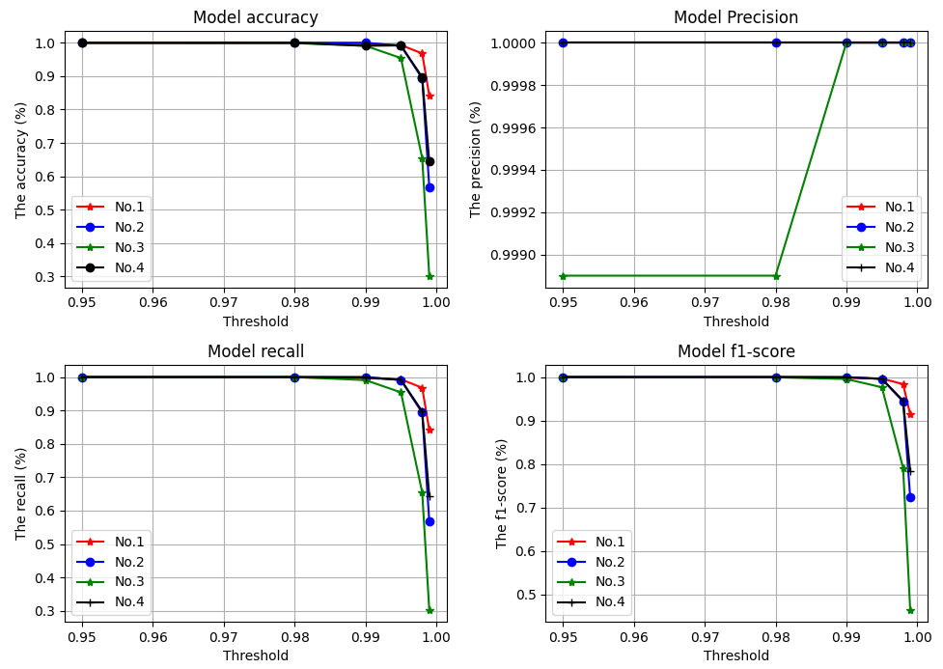
Results
Set different thresholds for each group of hyperparameter combinations:
Ao Ding IVSign: Interpretable Vulnerability Signature via Code Embedding and Static Analysis

Slide 23
Table of Contents
Background
Related Work
The Proposed IVSIGN framework
Experiments
Discussion
Summary
Ao Ding IVSign: Interpretable Vulnerability Signature via Code Embedding and Static Analysis

Slide 24
Discussion
Due to time and level constraints, there are still some shortcomings in our work:
- Our work is only focused on open-source projects in C/C++. Some experiments are needed to illustrate the problem.
- CodeBERT’s pretraining dataset does not include C/C++. The embedding of the code may be better obtained if a C-based pre-trained model is used.
- Due to time and computational resource constraints, we did not conduct extensive experiments on the hyper-parameters. Future experiments on different datasets will be
needed to explore the effectiveness of the models.
- it is important to explore a better integration of pattern-driven approaches and data-driven approaches to provide more information, better results, and better interpretability.
Ao Ding IVSign: Interpretable Vulnerability Signature via Code Embedding and Static Analysis

Slide 25
Table of Contents
Background
Related Work
The Proposed IVSIGN framework
Experiments
Discussion
Summary
Ao Ding IVSign: Interpretable Vulnerability Signature via Code Embedding and Static Analysis

Slide 26
Summary
Propose an Interpretable vulnerability signature (IVSign) scheme to combine pattern-driven and data-driven methods.
Different from existing methods, we introduce Code-BERT and Bi-LSTM to map data dependency graphs into vulnerability signatures.
Through a series of experiments, the evaluation metrics of the model all exceeded 90% when appropriate thresholds were set, demonstrating that IVSign has excellent results
Ao Ding IVSign: Interpretable Vulnerability Signature via Code Embedding and Static Analysis
Notes:
后面简单讲一点future works，比如提一下变换复杂度

Slide 27
Thank you!
Q&A
Ao Ding IVSign: Interpretable Vulnerability Signature via Code Embedding and Static Analysis

